Slide 1
ECE P520 Week 5
C++

Slide 2
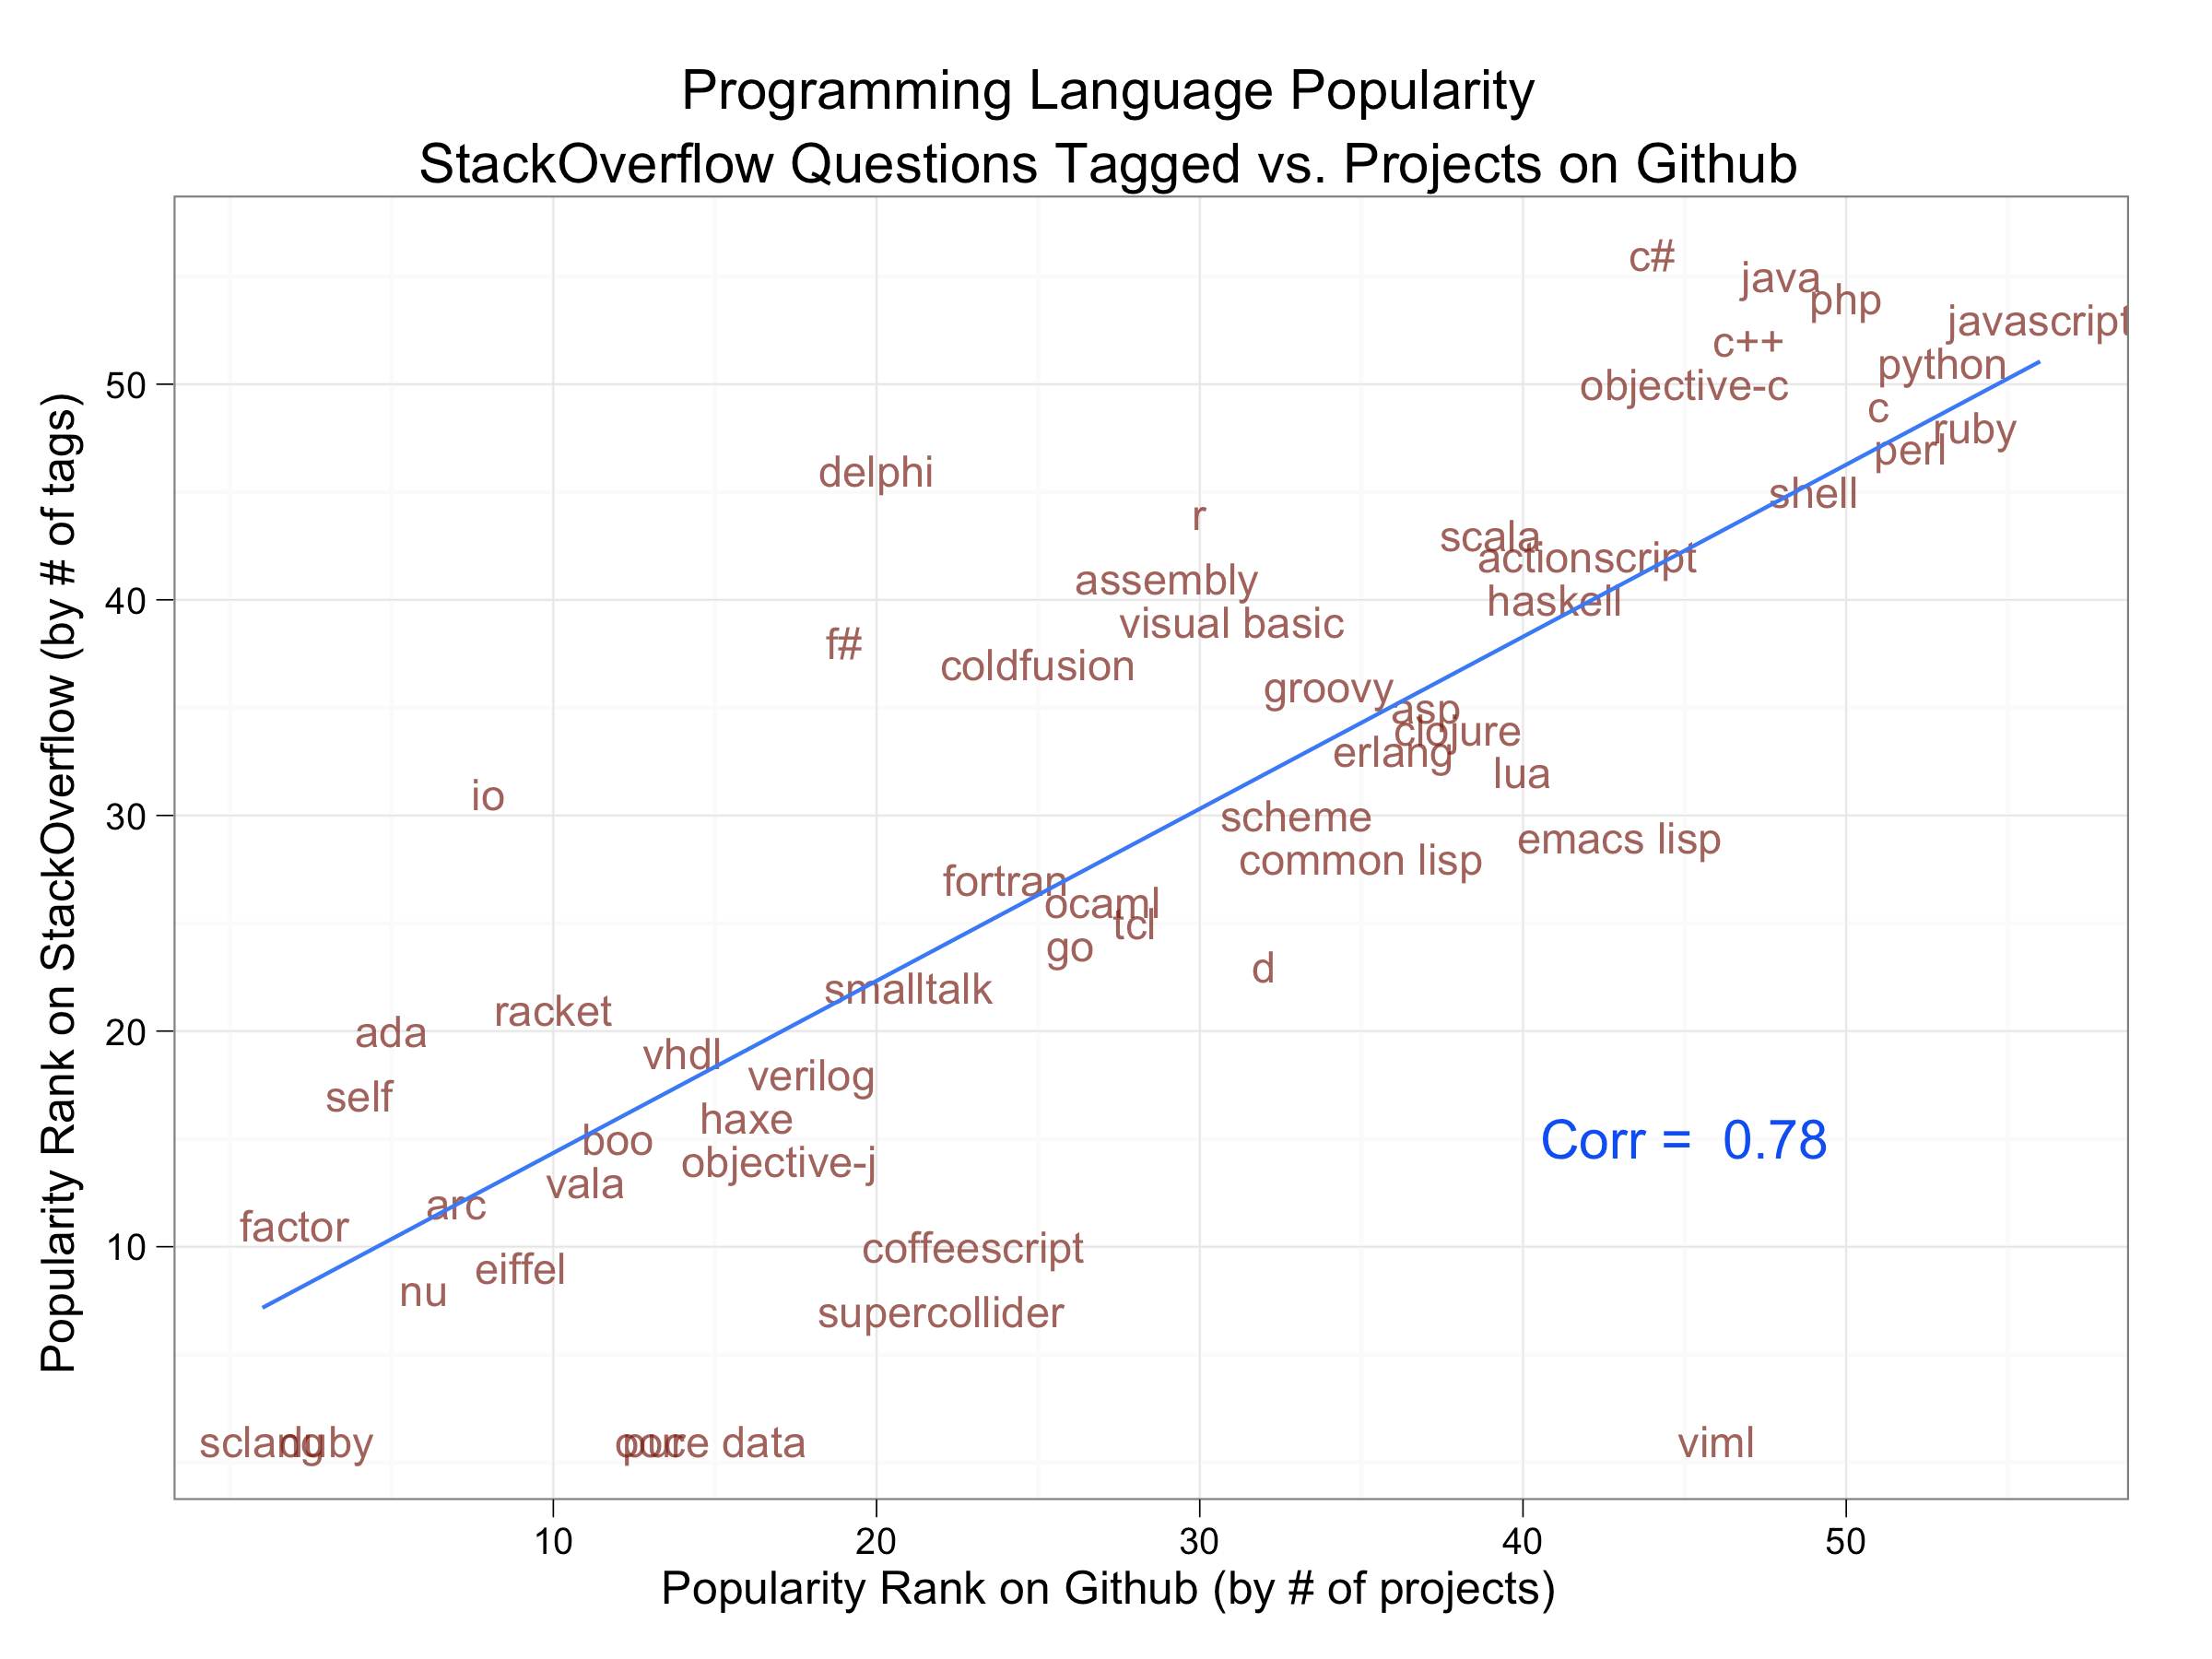
Programming Language Usage
C is more popular in Github projects,
But people have more questions about C++.
http://www.dataists.com/2010/12/ranking-the-popularity-of-programming-langauges/

Slide 3
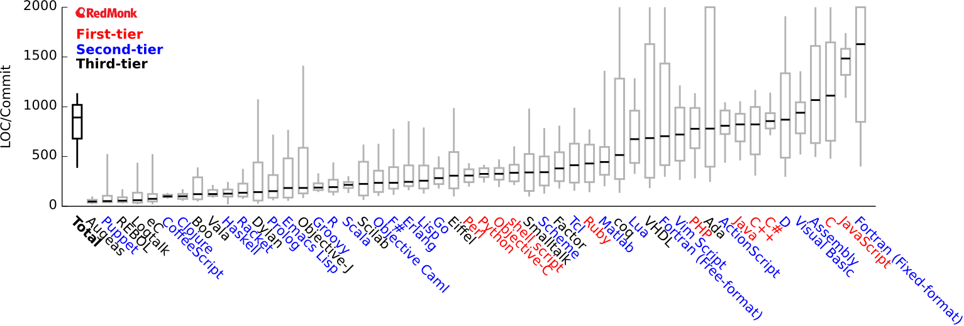
Programming Language Expressivity
Or is it productivity?
C++ is slightly more expressive than C?
More variability in expressive languages.
The most expressive languages are the least used.
http://redmonk.com/dberkholz/2013/03/25/programming-languages-ranked-by-expressiveness/

Slide 4
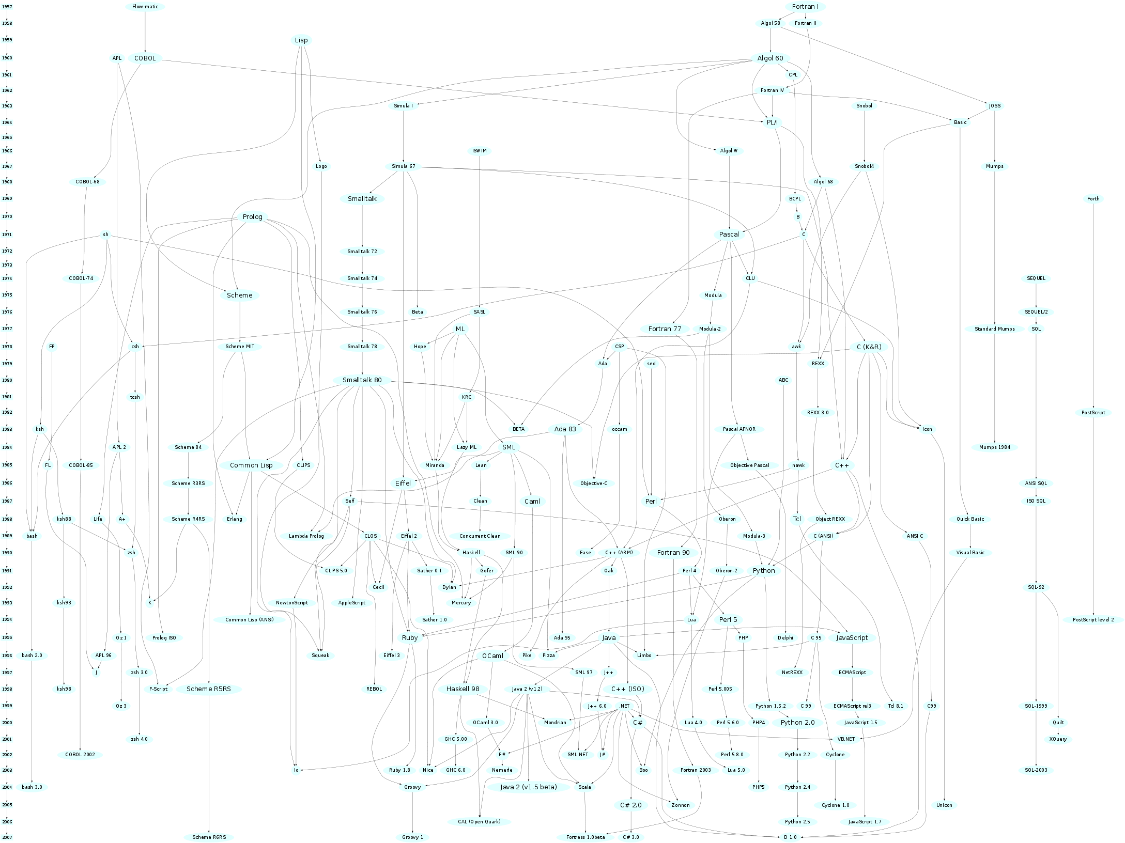
Programming languages come and go.
But good ideas stick around, evolve, and appear in other languages.
You don’t know what language you will be using 10 years from now.

Slide 5
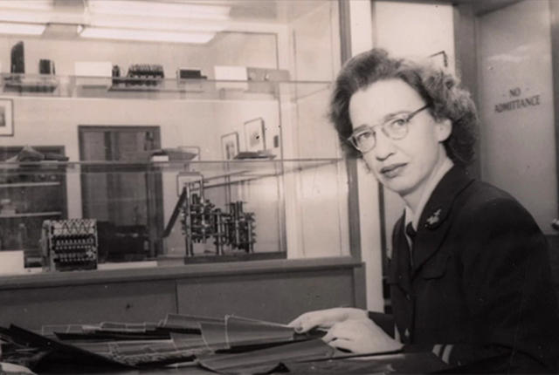
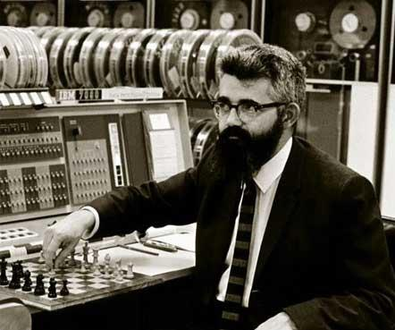
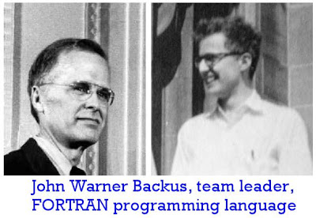
In the beginning there was Flow-matic, Lisp, and Fortran, ...
Grace Hopper (Navy, EMCC)
John McCarthy (MIT)
John Backus (IBM)
Business
Science and Engineering
(imperative, procedural)
AI (functional)

Slide 6
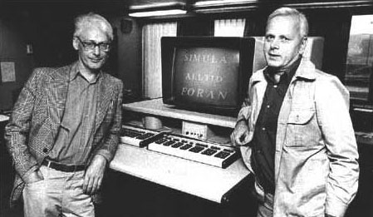
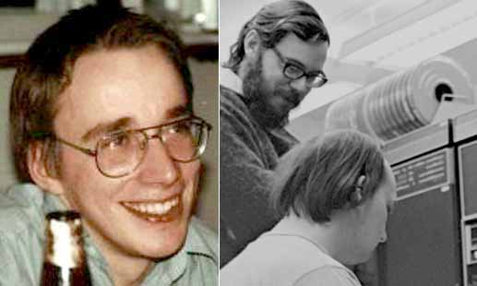
Ole-Johan Dahl and Kristen Nygaard
Types, pointers, ...
Object Oriented!
UNIX!
Dennis Ritchie (Bell Labs)
1985

Slide 7
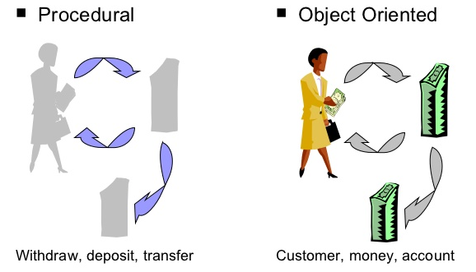
Object Oriented
A class defines the type of an object in terms of its
Attributes and
Methods
Inheritance shows how classes can be derived from other classes.
The implementation is supposed to be hidden from the user of the class.
The good
Code reuse
Scalability
Easy collaboration
The bad
Dogmatic
Requires training to code correctly
Some things really are just procedural

Slide 8
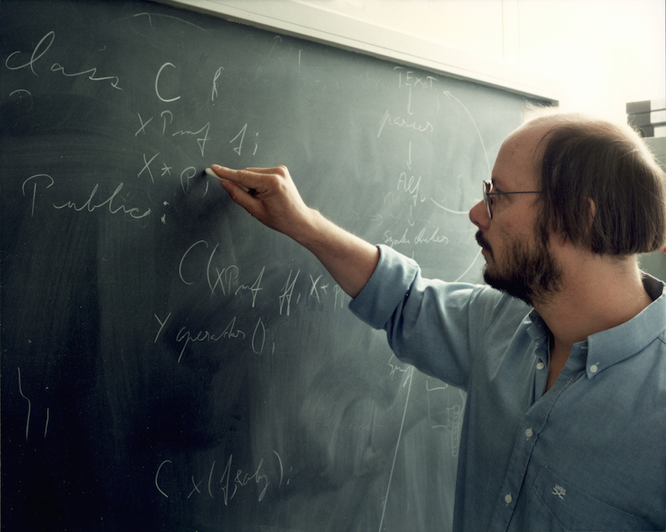
C++
Until C++, OOP was mostly academic
Stroustrup’s goal: Combine Simula and other OOP ideas with a practical language like C.
1985 (while at Bell Labs and Columbia U)
classes
derived classes / inheritance
strong typing
inlining
default arguments
virtual functions
function name and operator overloading
constants
type-safe free-store memory allocation (new/delete)
improved type checking
single-line comments with two forward slashes (//)
Bjarne Stroustrup
Later
templates
exceptions
namespaces
boolean type
1989-1990
multiple inheritance
abstract classes
static member functions
const member functions
and protected members
Recently
anonymous functions

Slide 9
C and C++ Uses
C
Operating systems, embedded systems, libraries, compilers, interpreters, intermediate languages
Cars, planes, boats, phones, Linux, Python, MATLAB, Mathematica, MySQL, ...
C++
Big software: IE, Chrome, Firefox, Safari, Microsoft Office, OpenOffice, Outlook, Facebook, YouTube, Media Player, iPod software, MySQL, MongoDB, Windows UI, MacOS UI, Microsoft Visual Compiler, …
Games: Doom III, Counter Strike, Sierra On-line: Birthright, Hellfire, Football Pro, Bullrider I & II, Trophy Bear, King’s Quest, Antara, Hoyle Card games suite, SWAT, Blizzard: StarCraft, StarCraft: Brood War, Diablo I, Diablo II: Lord of Destruction, Warcraft III, World of Warcraft, Starfleet Command, Invictus, PBS's Heritage: Civilization and the Jews, Master of Orion III, CS-XII, MapleStory etc. Microsoft games.

Slide 10
Linus Torvalds on C++
C++ is a horrible language. It's made more horrible by the fact that a lot of substandard programmers use it, to the point where it's much much easier to generate total and utter crap with it. Quite frankly, even if the choice of C were to do *nothing* but keep the C++ programmers out, that in itself would be a huge reason to use C.
I've come to the conclusion that any programmer that would prefer the project to be in C++ over C is likely a programmer that I really *would* prefer to piss off, so that he doesn't come and screw up any project I'm involved with.

Slide 11
Nevertheless…
If you establish conventions and stick to well understood patterns, you should be fine.

